Slide 1
Quadruped

Slide 2
Abstract
In many cases, there is a need for mobile platforms that can move in areas with difficult terrain conditions where wheeled vehicles cannot travel. Unlike wheeled robots, walking robots are characterized by very good mobility in rough terrain
A quadruped is presented in its initial phase with 2 DOF leg. Further, the quadruped is designed to be incorporated with 3 DOF and passive spine to assist foot movement for different Gait Cycle.
Applications: The robot is designed with an aim to be used in disaster relief assisting operation and other operation which requires maneuvering over uneven terrains. Examples of such scenarios can be seen in search and rescue tasks, as well as in carrying payloads.

Slide 3
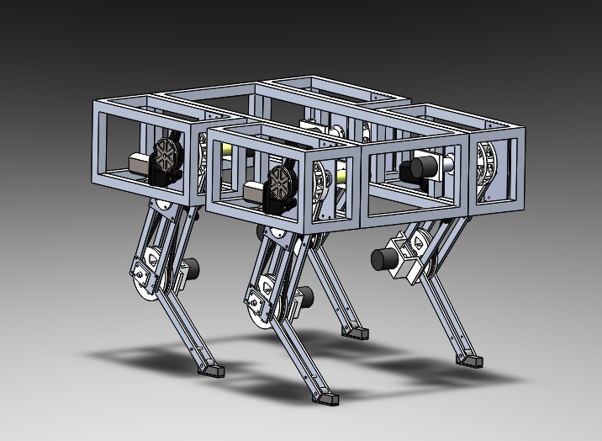
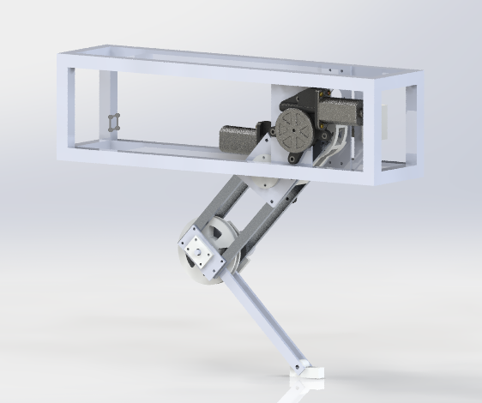
Solidworks Model
Currently, the dimension of the quadruped is 600*500*450 mm and weight 12kg.

Slide 4
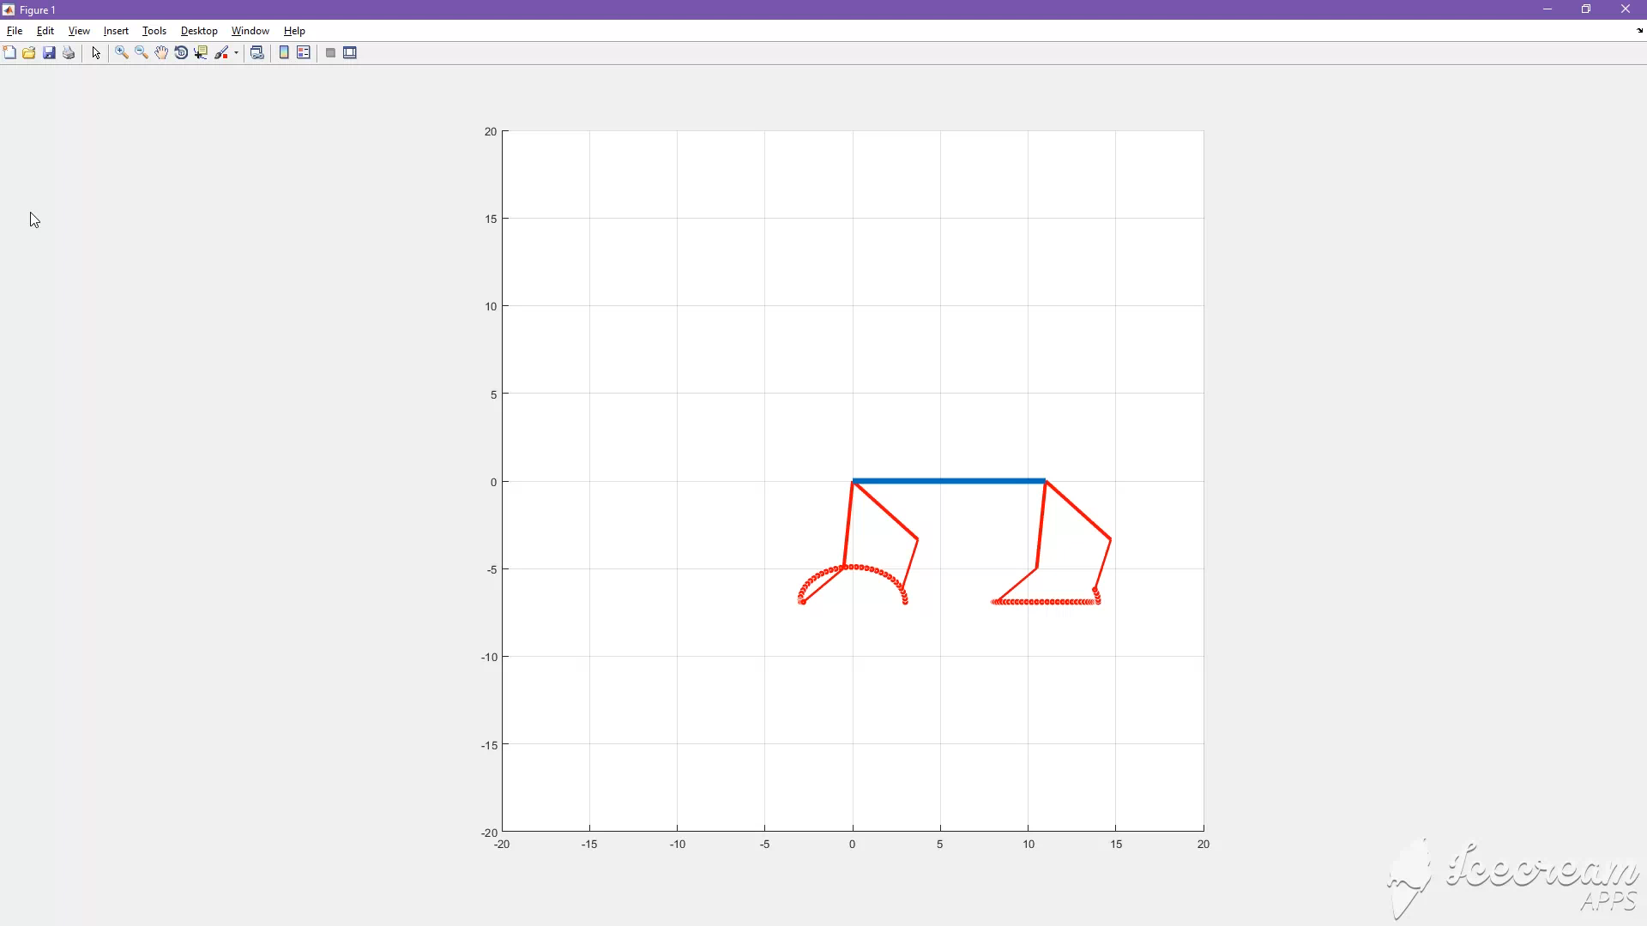
Simulation
Following is the simulation for the design Walk Gait cycle using MATLAB.

Slide 5
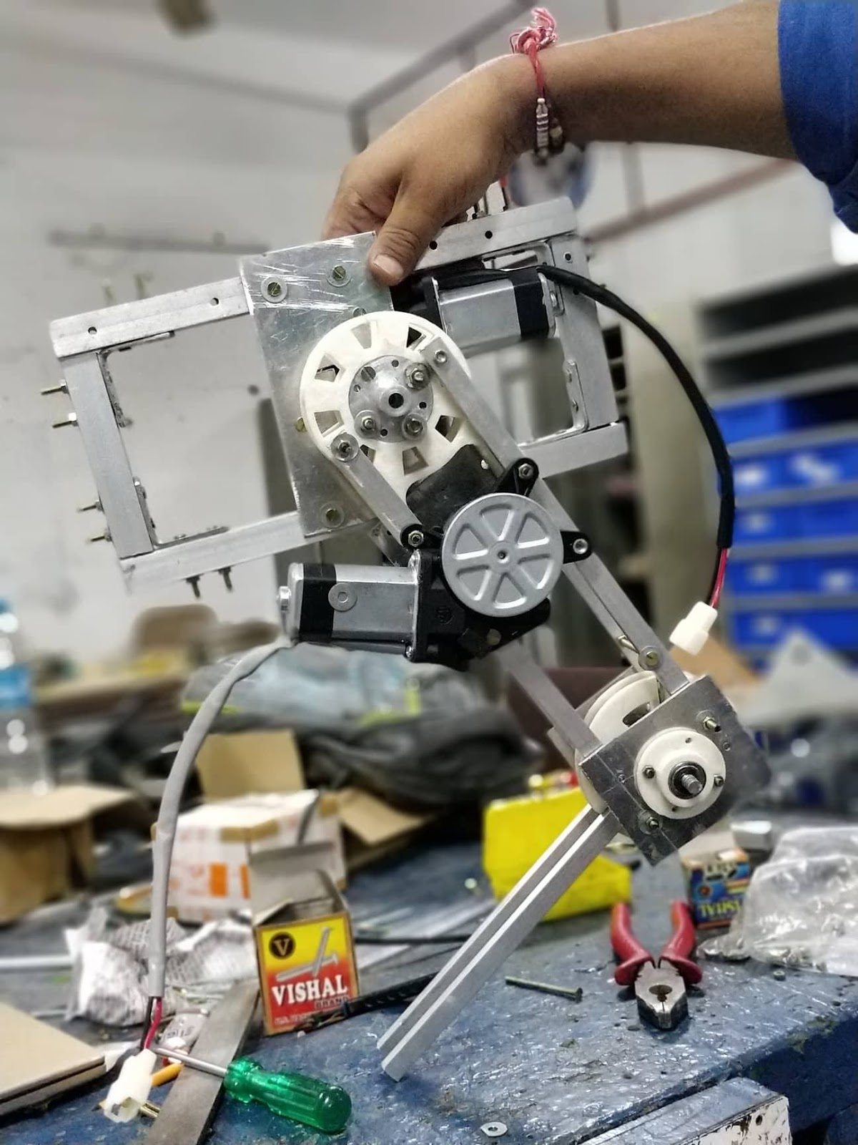
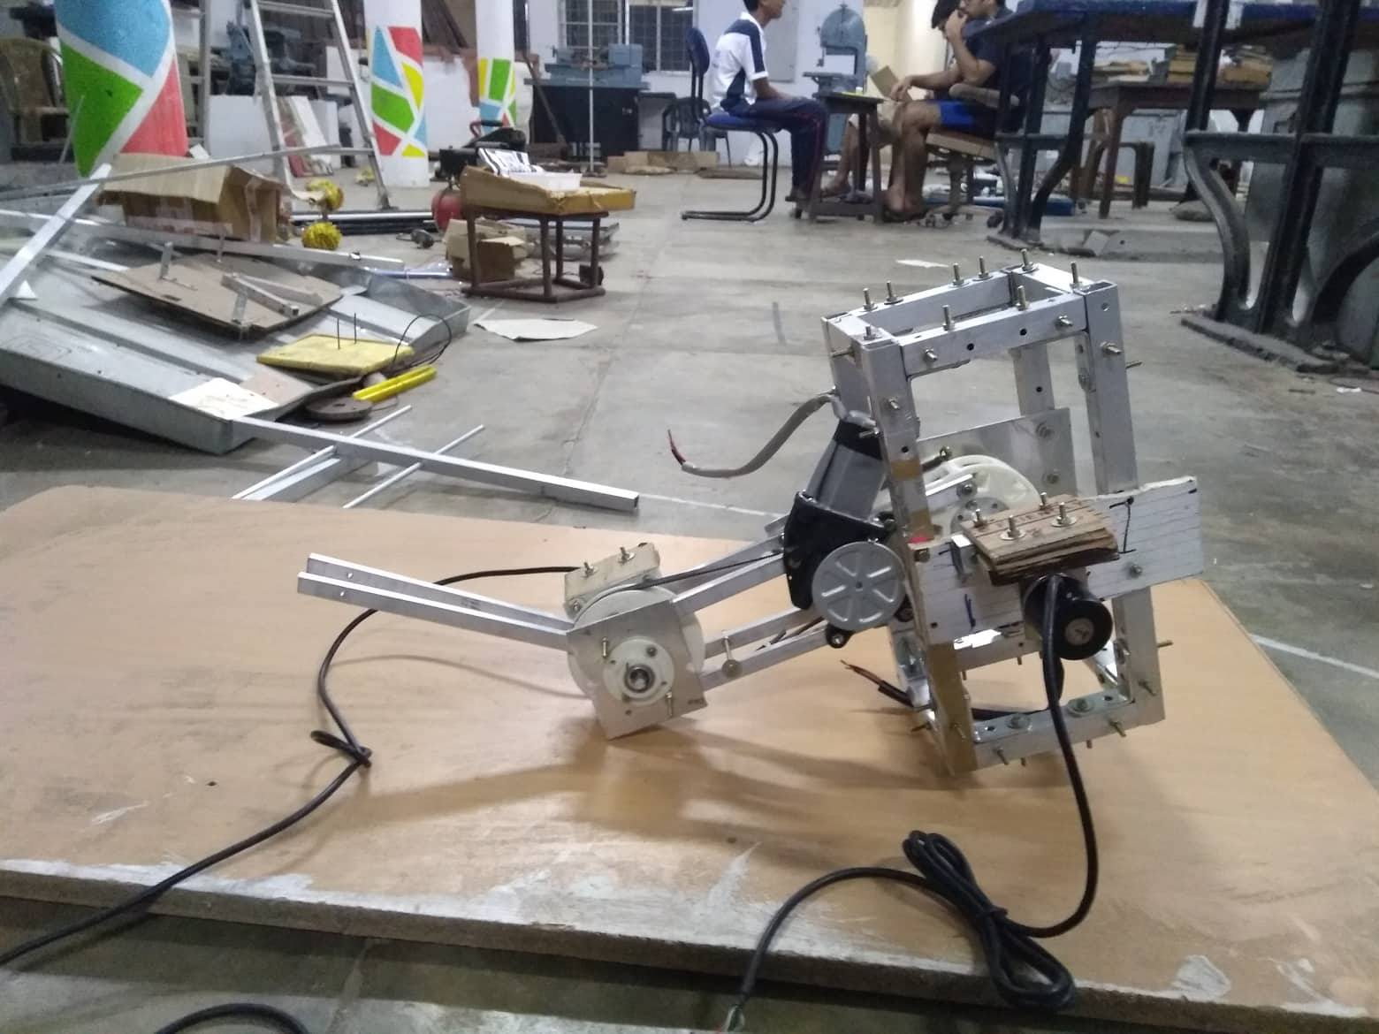
Prototype
Currently, one leg is manufactured for prototype testing of our design system. Also the design is simulated in MATLAB for dynamic forces at different gait cycles.

